Slide 1
Operating System

Slide 2
What is an Operating System?
A program that acts as an intermediary between a computer user and the computer hardware.
Operating System can be defined as an interface between user and the hardware. It provides an environment to the user so that, the user can perform its task in a convenient and efficient way.
Operating system goals:
Execute user programs and make solving user problems easier
Make the computer system convenient to use
Use the computer hardware in an efficient manner

Slide 3
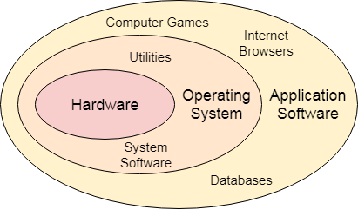
What is an Operating System?
An Operating System can be defined as an interface between user and hardware. It is responsible for the execution of all the processes, Resource Allocation, CPU management, File Management and many other tasks.
The purpose of an operating system is to provide an environment in which a user can execute programs in convenient and efficient manner.

Slide 4
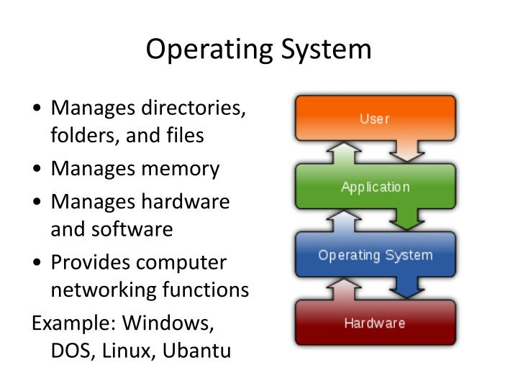
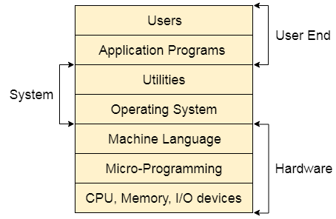
4

Slide 5
Computer System Structure
Computer system can be divided into four components:
Hardware: provides basic computing resources CPU, memory, I/O devices, disks, etc.,
Operating system: Controls and coordinates use of hardware among various applications and users.
Application programs: define the ways in which the system resources are used to solve the computing problems of the users, Word processors, compilers, web browsers, database systems, video games, etc.,
Users: People, machines, other computers.

Slide 6

Four Components of a Computer System

Slide 7
Defining Operating System
No universally accepted definition of what an OS:
In the Computer System (comprises of Hardware and software), Hardware can only understand machine code (in the form of 0 and 1) which doesn't make any sense to a naive user.
An Operating System can be defined as an interface between user and hardware. It is responsible for the execution of all the processes, Resource Allocation, CPU management, File Management and many other tasks.
The purpose of an operating system is to provide an environment in which a user can execute programs in convenient and efficient manner.

Slide 8
Defining Operating System (Cont.)
No universally accepted definition of what is part of the OS:
A more common definition, and the one that we usually follow, is that the operating system is the one program running at all times on the computer -- usually called the kernel. (Kernel is the core part of an operating system which manages system resources. It also acts like a bridge between application and hardware of the computer.)
Along with the kernel, there are two other types of programs:
System programs, which are associated with the operating system but are not necessarily part of the kernel.
Application programs, which include all programs not associated with the operation system.

Slide 9
Defining Operating System (Cont.)
No universally accepted definition of what is part of the OS:
A kernel is the central component of an operating system. It manages the system’s resources and provides common services for computer programs.
The only job performed by the kernel is to the manage the communication between the software and the hardware.
Functions of kernel
The kernel is the core component of an operating system which acts as an interface between applications, and the data is processed at the hardware level.
When an OS is loaded into memory, the kernel is loaded first and remains in memory until the OS is shut down.
After that, the kernel provides and manages the computer resources and allows other programs to run and use these resources.
The kernel also sets up the memory address space for applications, loads the files with application code into memory, and sets up the execution stack for programs.

Slide 10

A Simple Program
What is the output of the following program?
How is the string displayed on the screen?

Slide 11
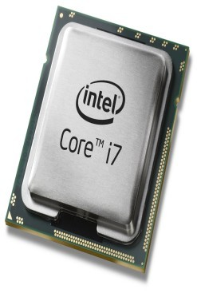
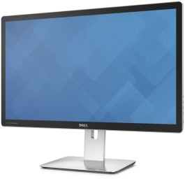
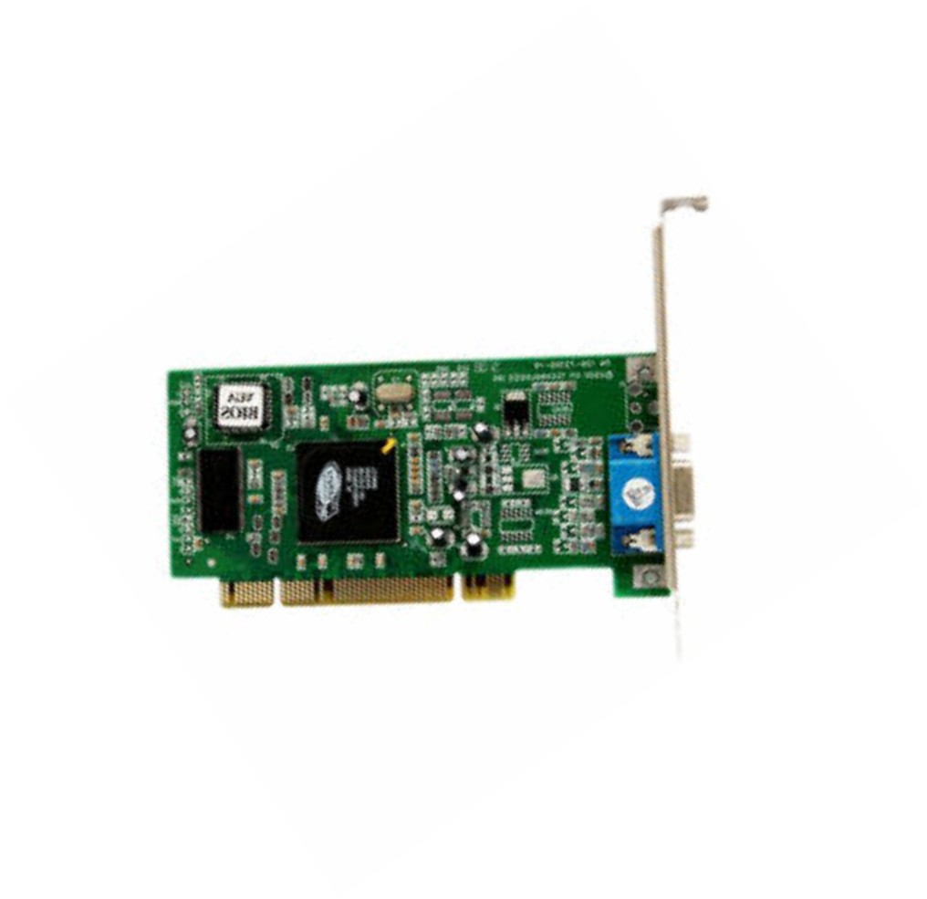
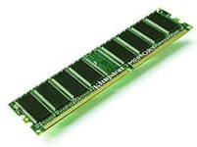
Displaying on the Screen
“Hello World”
“Hello World” +
coordinates, color, depth, etc
Monitor
Processor
Processor Memory
Graphics Card
•
•
Can be complex and tedious Hardware dependent
Without an OS, all programs need to take care of every nitty gritty detail

Slide 12
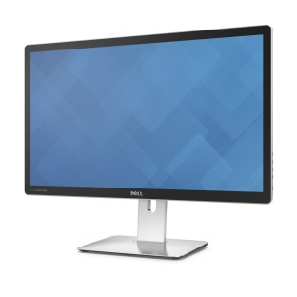
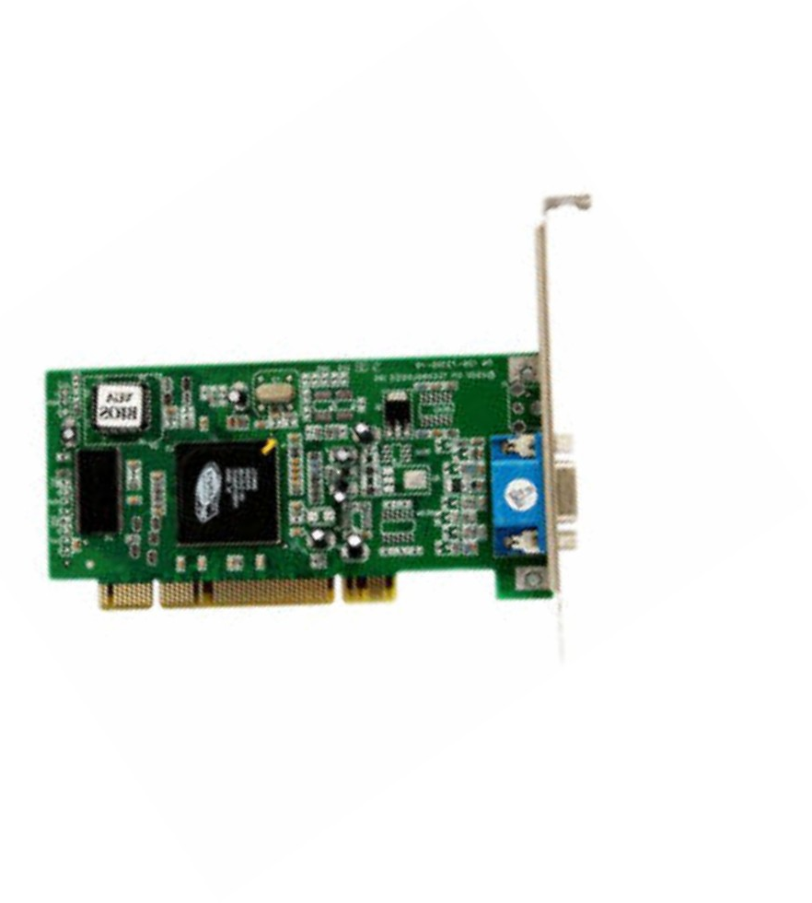
Operating Systems Provide Abstraction
App
system call (write to STDOUT)
Operating System
Device driver
•
Easy to program apps
– No more nitty gritty details for programmers
•
Reusable functionality
– Apps can reuse the OS functionality
•
Portable
– OS interfaces are consistent. The app does not change when hardware changes

Slide 13
What Operating System Do
The operating system controls the hardware and coordinates its use among the various application programs for the various users.
We can also view a computer system as consisting of hardware, software, and data.
The operating system provides the means for proper use of these resources in the operation of the computer system.
An operating system is similar to a government. Like a government, it performs no useful function by itself. It simply provides an environment within which other programs can do useful work.
To understand full the operating system's role, we explore operating systems from two viewpoints:
The user
The system.

Slide 14
User View
The user's view of the computer varies according to the interface being used
Single user computers (e.g., PC, workstations). Such systems are designed for one user to monopolize its resources. The goal is to maximize the work (or play) that the user is performing. The operating system is designed mostly for ease of use and good performance.
Multi user computers (e.g., mainframes, computing servers). These users share resources and may exchange information. The operating system in such cases is designed to maximize resource utilization -- to assure that all available CPU time, memory, and I/O are used efficiently and that no individual users takes more than their air share.

Slide 15
User View (Cont.)
Handheld computers (e.g., smartphones and tablets). The user interface for mobile computers generally features a touch screen. The systems are resource poor, optimized for usability and battery life.
Embedded computers (e.g., computers in home devices and automobiles) The user interface may have numeric keypads and may turn indicator lights on or off to show status. The operating systems are designed primarily to run without user intervention.

Slide 16
System View
From the computer's point of view, the operating system is the program most intimately involved with the hardware. There are two different views:
The operating system is a resource allocator
Manages all resources
Decides between conflicting requests for efficient and fair resource use
The operating system is a control program
Controls execution of programs to prevent errors and improper use of the computer

Slide 17
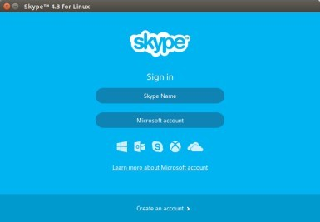
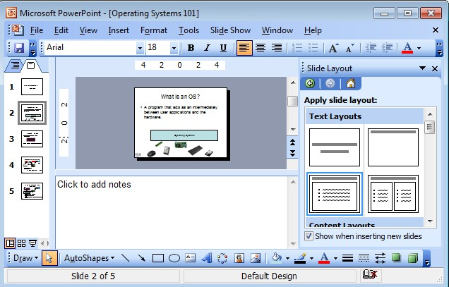
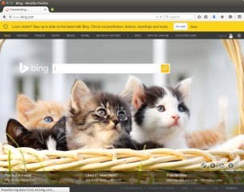
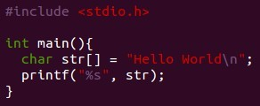

OS as a Resource Manager
Multiple apps but limited hardware
Apps
Operating Systems
A few processors

Slide 18
Operating Systems
(How did it all start?)

Slide 19
OS Evolution
Evolution driven by Hardware improvements + User needs
eg. low power requirements,
Increased / reduced security,
lower latency
Evolution by
New/better abstractions
New/better resource management
New/better low level implementations

Slide 20
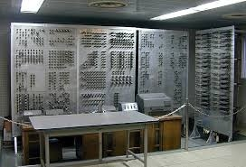
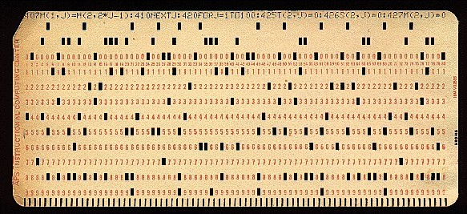
Gen 1: Vacuum Tubes
•
Hardware
–
–
Vacuum tubes and IO with punchcards Expensive and slow
•
User Apps
– Generally straightforward numeric computations done in machine language
IBM Punch card
ENIAC

Slide 21

Gen 1 : OS
OS: Unheard of
Human feeds program and prints output
George Ryckman, on IBM’s first computer
The cost of wastage was $146,000 per month (in 1954 US Dollars)

Slide 22
Gen 2 : Mainframes
Hardware
transistors
User Programs
Assembly or Fortran entered using punch cards
OS : Batch systems
Possibly greatest invention in OS
Computers may be able to schedule their own workload by means of software

Slide 23
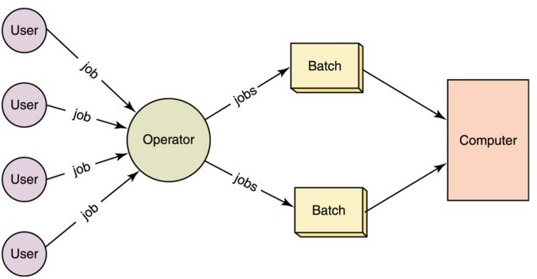
Batch Systems
Operator collects jobs (through punch cards) and feeds it into a magnetic tape drive
Special Program reads a job from input tape drive and on completion writes result to output tape drive
The next program is then read and executed Printing was done offline

Slide 24
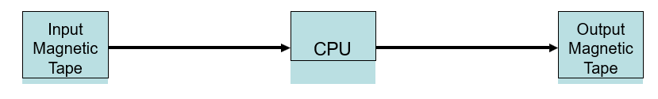
Batch Systems (pros.)
Pros
– Better utilization of machine
Batch Systems (cons.)
In Batch Systems execute time includes reading from input and writing to output.
I/O considerably slower than execution
– Magnetic tapes were best read sequentially
Therefore programmer must wait for long time

Slide 25
Gen 3 : Mini computers
Hardware
SSI/MSI/LSI ICs
Random access memories
Interrupts (used to simulate concurrent execution)
User Programs
High level languages (Fotran, COBOL, C, …)
Operating Systems
Multiprogramming
Spooling

Slide 26
Multiprogramming
Multiple jobs in memory
When one waits for I/O the next job executes
OS controls
scheduling of jobs
Protection between jobs
Memory partitions
Multiprogramming with 3 jobs in memory
OS
Job 1
Job 2
Job 3

Slide 27
Spooling
•
Uses buffers to continuously stream inputs and outputs to the system
Disk
Input Magnetic Tape
Output Magnetic Tape
CPU
•
•
Pros : better utilization / throughput Cons : still not interactive

Slide 28
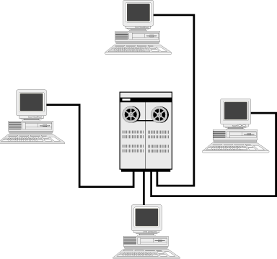
Timesharing
Who uses the CPU?
Terminal 1 | Terminal 2 | Terminal 3 | Terminal 4
time

Slide 29
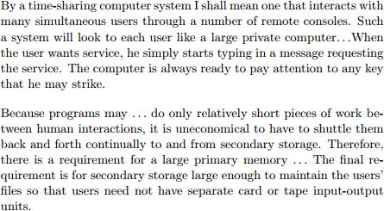
Timesharing
John McCarthy, 1962

Slide 30
Multics, 1964
•
•
•
Multiplexed Information and Computing Service Ambitious project started in MIT
Introduced several new OS features but was not successful by itself
Segmented and Virtual memory
High level language support
Multi language support
Security
File system hierarchies
Relational databases
Shared memory multiprocessor

Slide 31
Gen 4 : Personal Computers
Hardware
VLSI ICs
User Programs
High level languages
Operating Systems
Multi tasking
More complex memory management and scheduling
Synchronization
Examples : Windows, Linux, etc

Slide 32
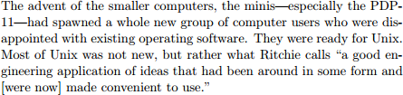
Unix
•
Dennis Ritchie and Ken Thomson tried to find an alternative for Multics
Appeared at the right time
•
Slater, 1987

Slide 33

Unix adopted
Spread and soon became widely adopted
Aho, 1984
Wide spread adoption arguably a hindrance to research?

Slide 34
Smartphones & Tablets
Hardware
VLSI ICs, low power requirements & high compute power
Operating Systems
User friendly
Power awareness
Always connected
Offload to cloud
Better protection, Virtual machines
Examples : Android, iOS

Slide 35
IoT and Edge Computing (Present-Future)
Operating systems are adapting to handle the unique challenges of interconnected devices and the need for real-time processing at the edge of networks.

Slide 36
OS Buzzwords
Buzzwords that have been around
Fairness
Security/ Reliability
Utilization
Isolation
Contemporary buzzwords
multi core support
energy / size
application specific OS
virtualization

Slide 37
OS Research Trends
Small
(footprint, Minimum energy requirements)
Security, Reliability
(fewer errors, Formally verified, fault tolerant)
Features
(better device support, Multi core support)

